Slide 1
How to create a dcf account

Slide 2
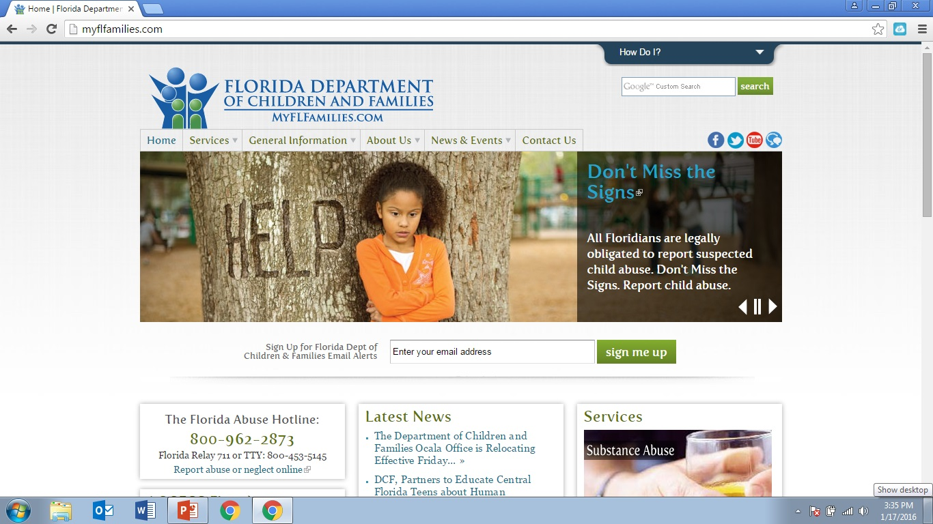
Go to myflfamilies.com

Slide 3
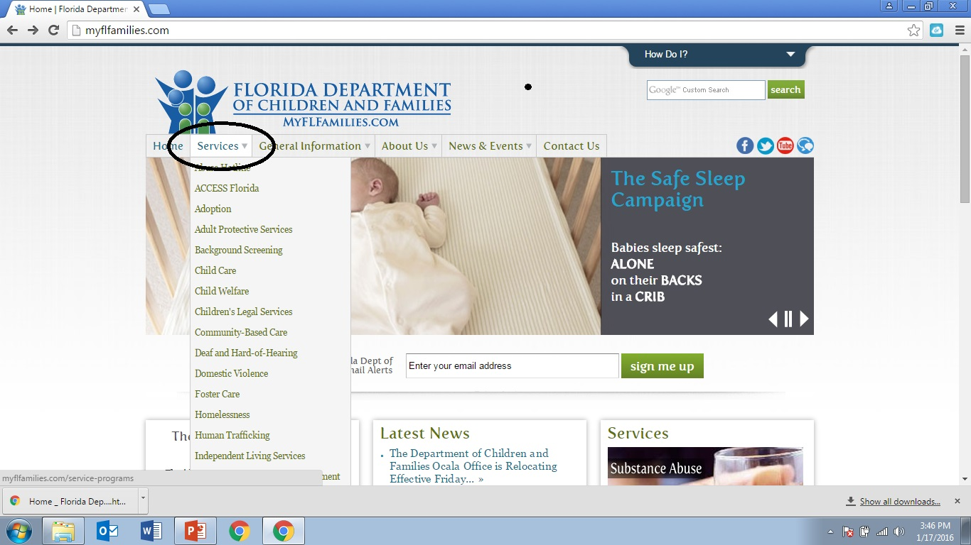
Hover over the services button.

Slide 4
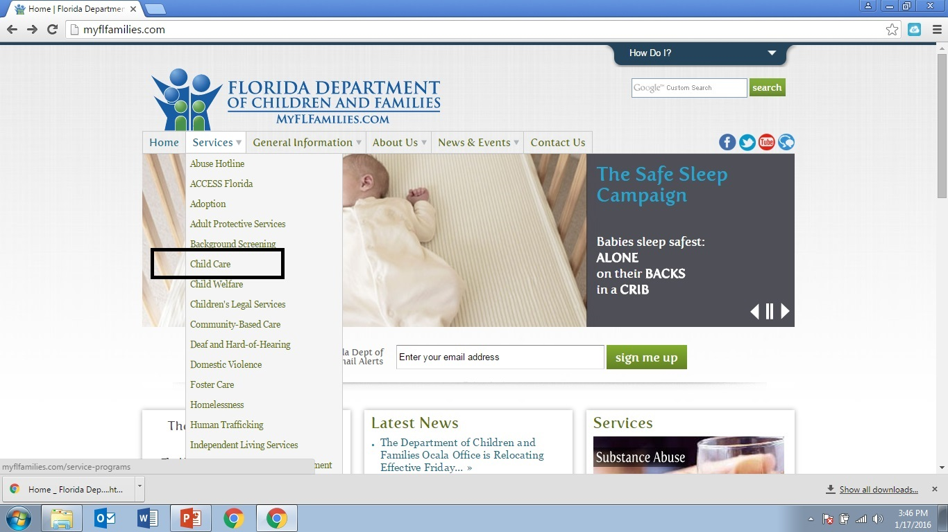
Click on Child Care

Slide 5
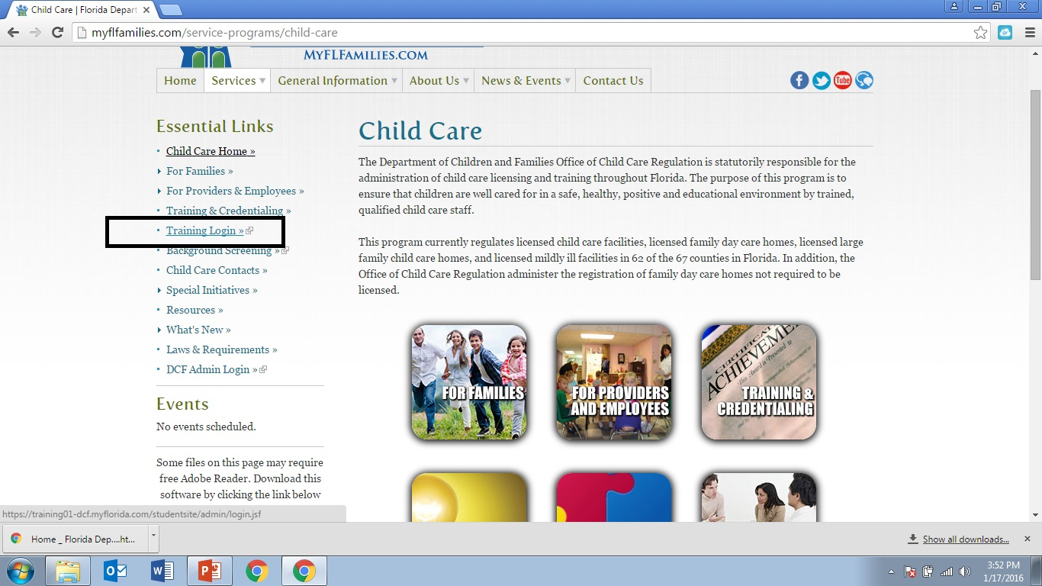
Click on Training Login under Essential Links or the button
under the Child Care section.

Slide 6
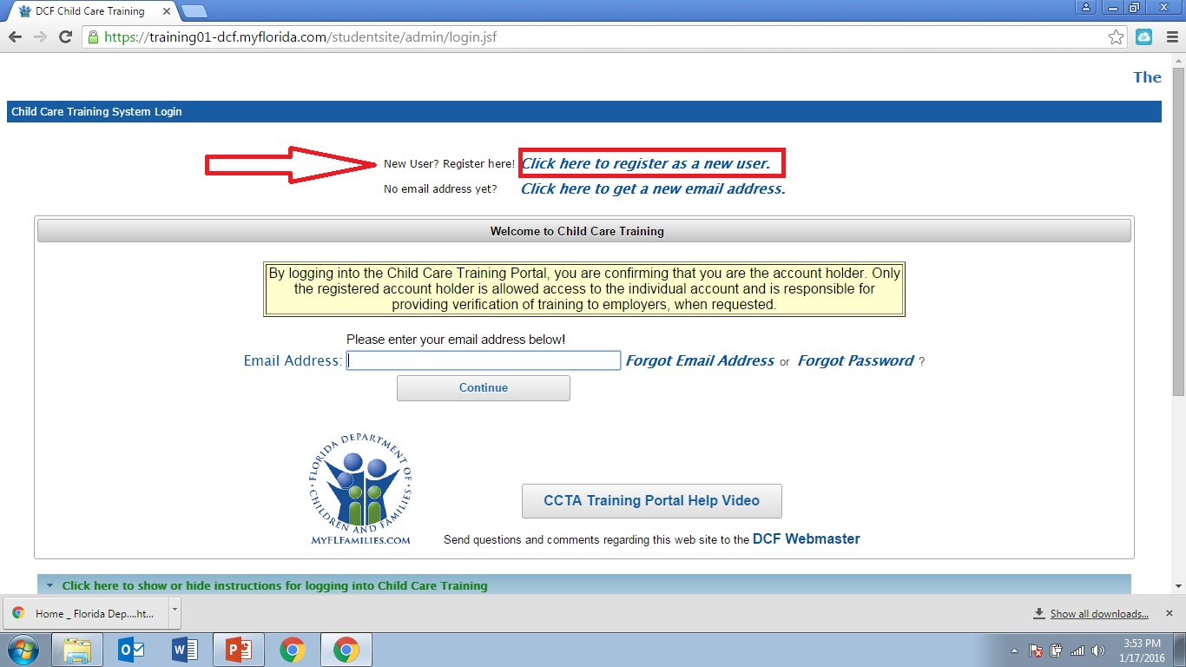
To create an account click where it says click here to register as a new user.

Slide 7
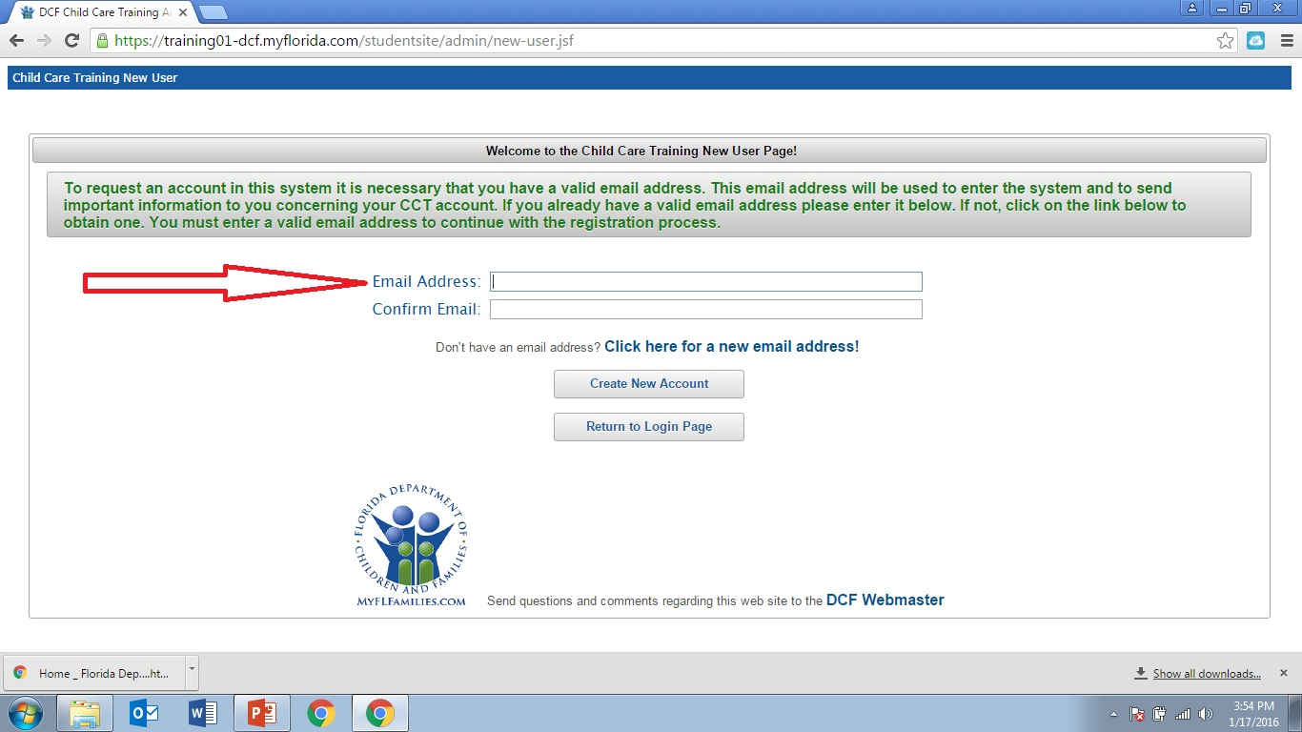
Enter an email account that you will remember.

Slide 8
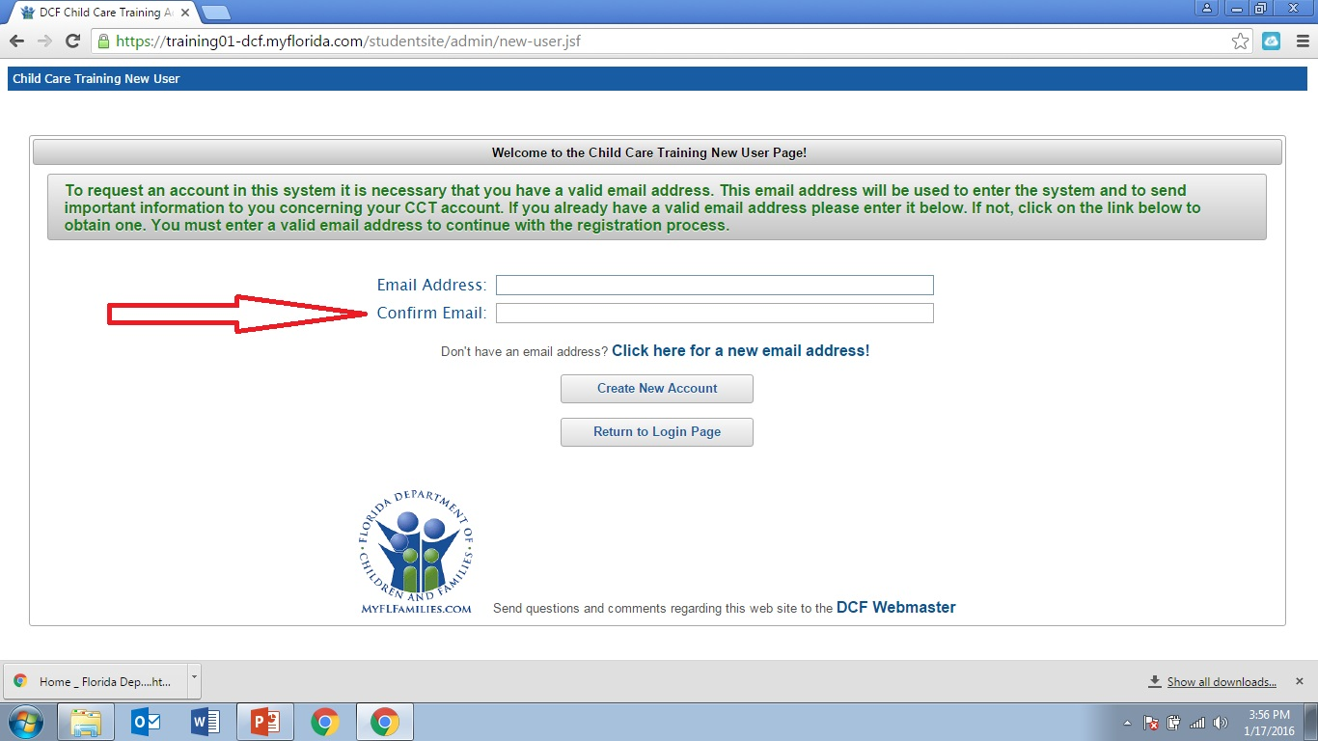
Re-enter the email to confirm it.

Slide 9
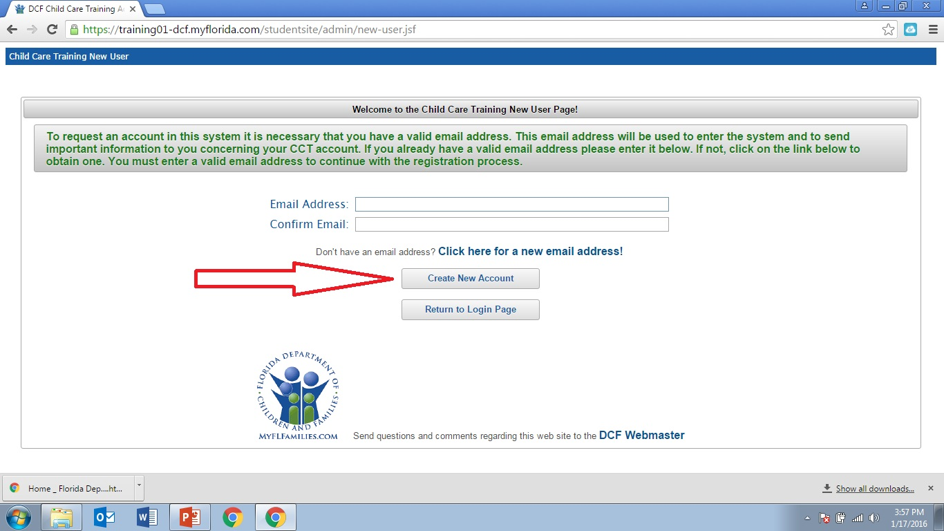
Then click Create New Account.

Slide 10
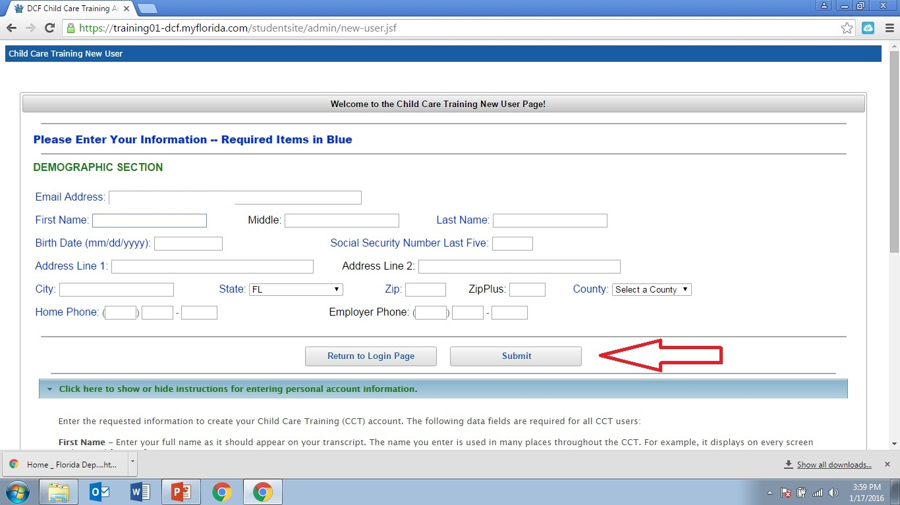
Fill out Demographic Section. You must have the last 5 digits of your Social Security Number.
Do not fill out the Employer Phone section.
Click on Submit when you have filled out this section.

Slide 11
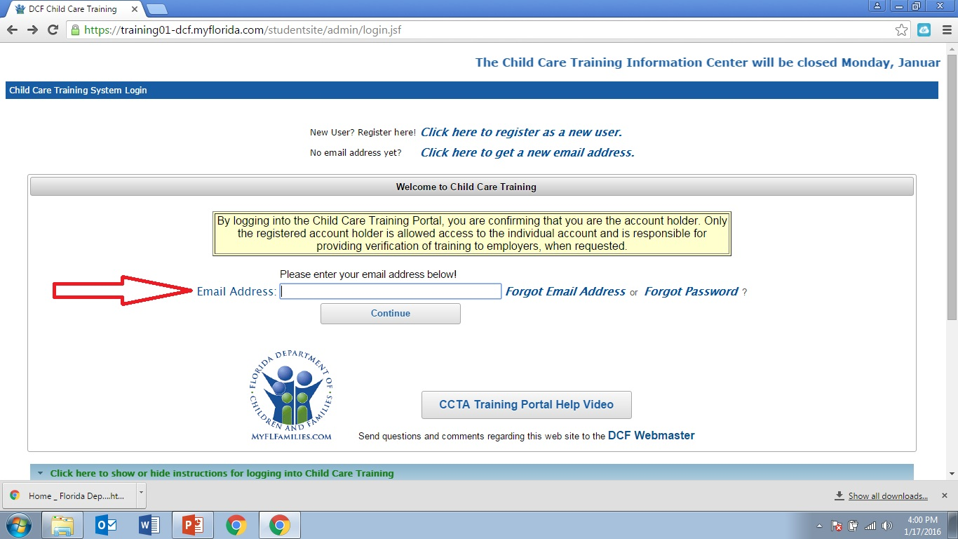
After you submit the website will give you a temporary password. It usually contains part of your name and 3 numbers. You should write it down .
The website will then take you back to the login page. You will enter your email and click Continue.

Slide 12
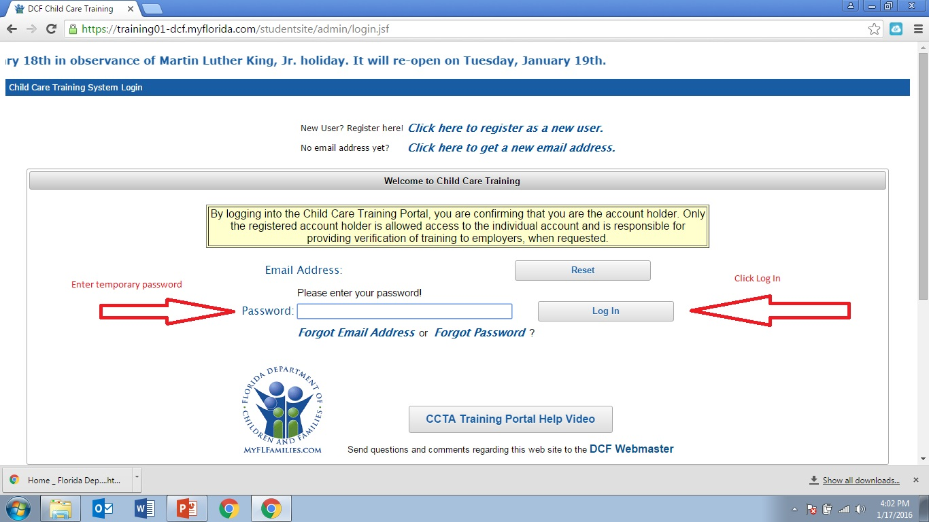
Enter your temporary password and click Log In.

Slide 13
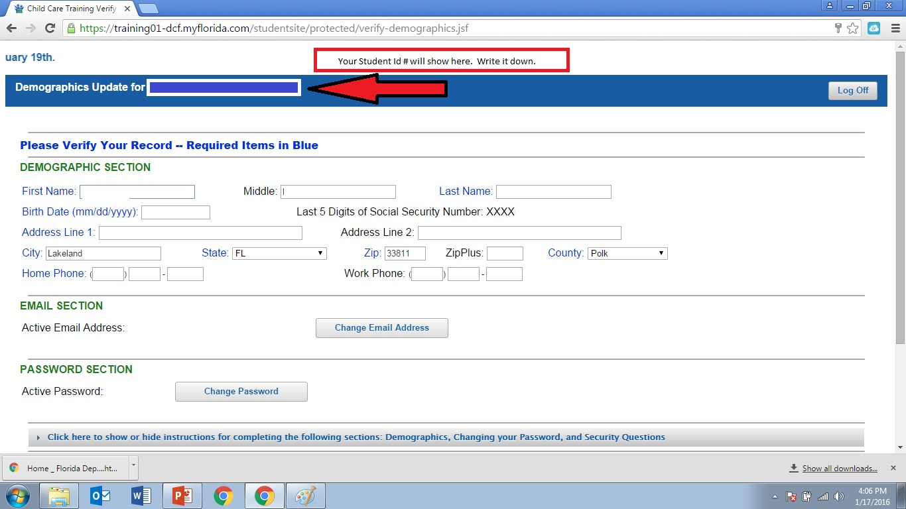
The Demographics page will pop back up.
Your Student Id will be in the top blue ribbon. Write that down as you need that to sign up for an exam.
Your Demographic section will be filled out with the information you provided earlier.
Scroll down and you will be able to create your own password. Remember to use a password you will remember.
Then you will choose reminder questions and create answers. Click submit.
The last thing you will do on this page is click save and continue.

Slide 14
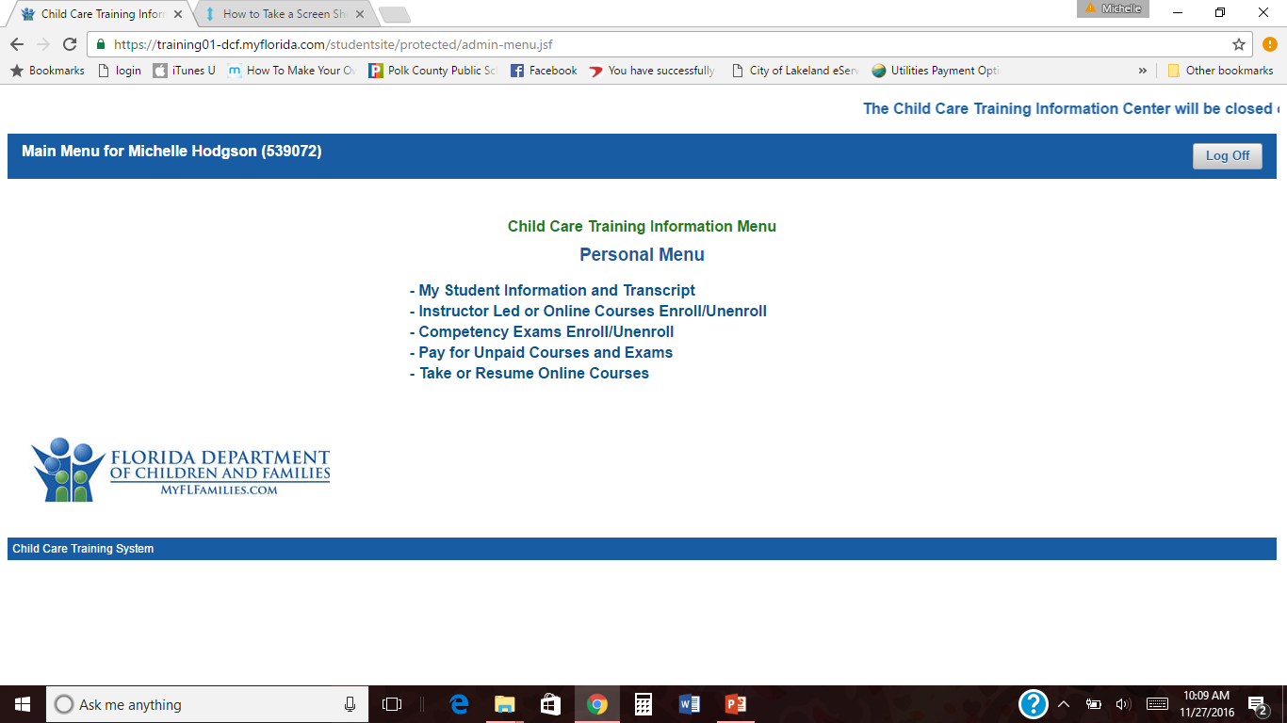
The Child Care Training Information Personal Menu will come up.
You need to click on
Instructor Led or Online Courses Enroll/ Unenroll.

Slide 15
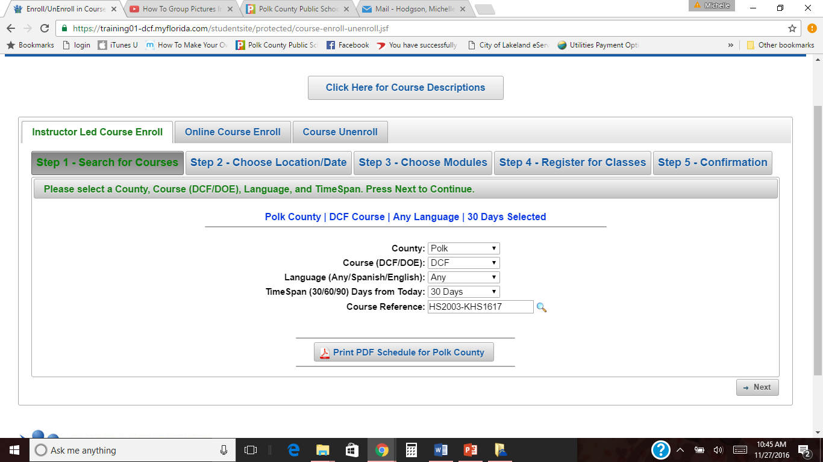
You will need to enroll in my course by entering HS2003-KHS1718
Under the Course Reference section.
Click next.

Slide 16
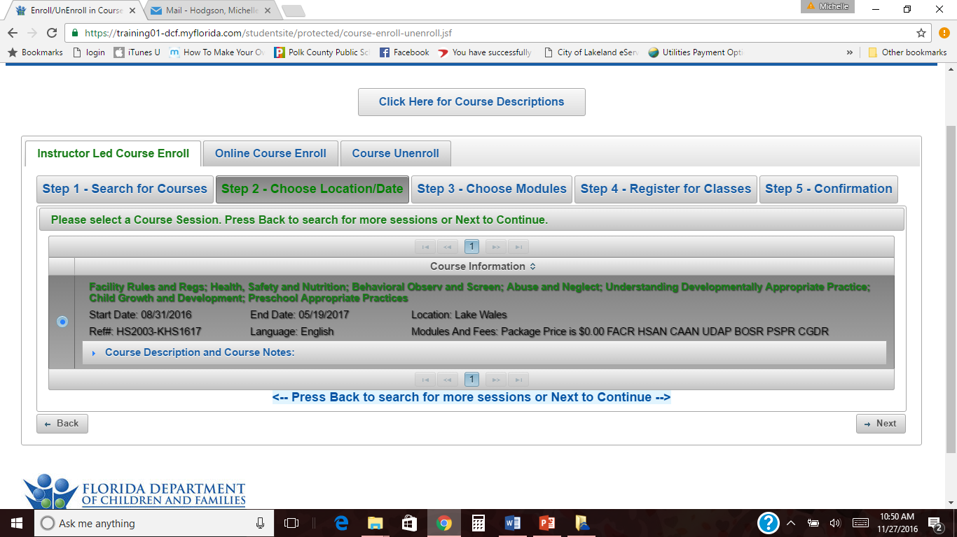
This is Step 2 of Course Enrollment.
Click the circle. Disregard the location Lake Wales. It is my course.
Click next.

Slide 17
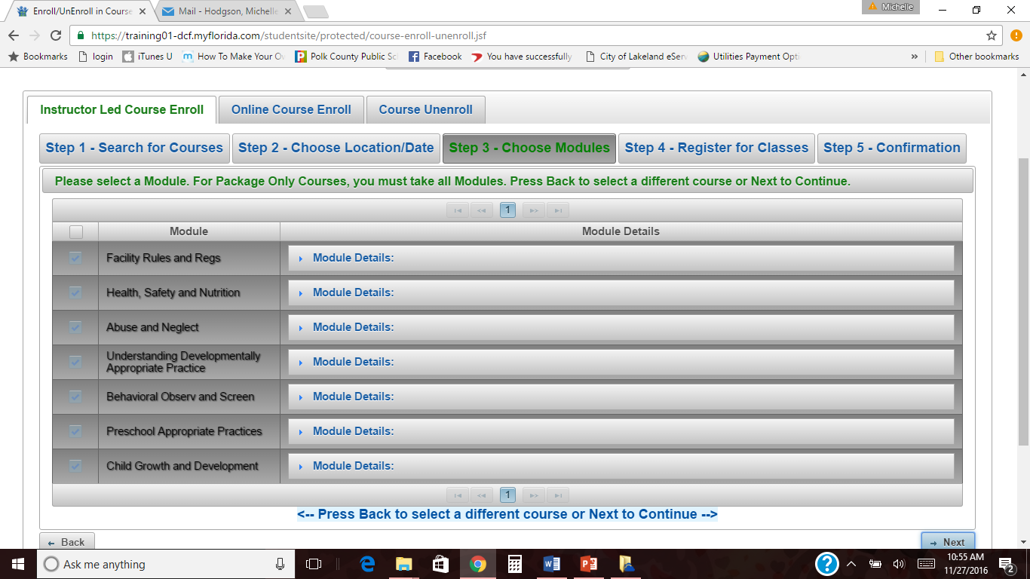
This is Step 3 of Course Enrollment.
All courses should be highlighted.
Click next.

Slide 18
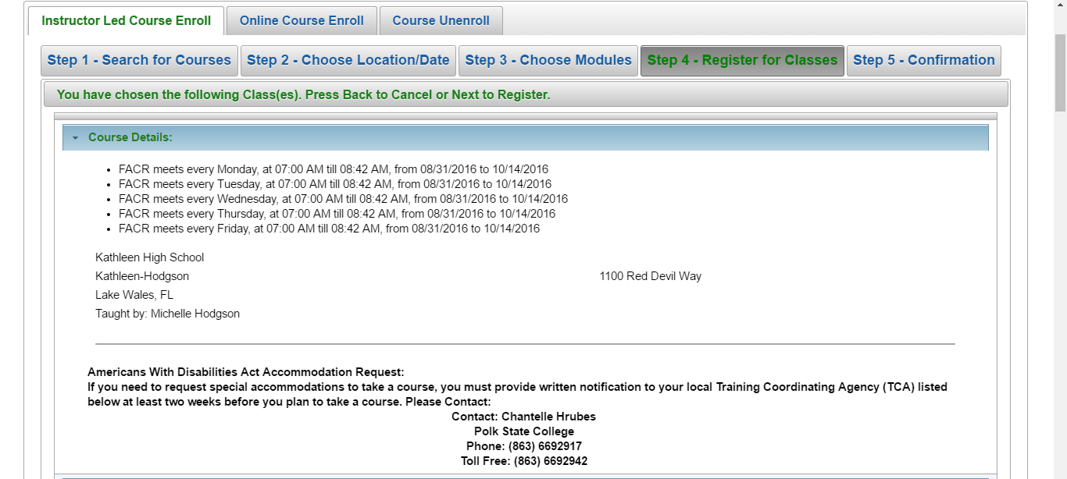
This is Step 4 of Course Enrollment.
Scroll to the bottom and click next.

Slide 19
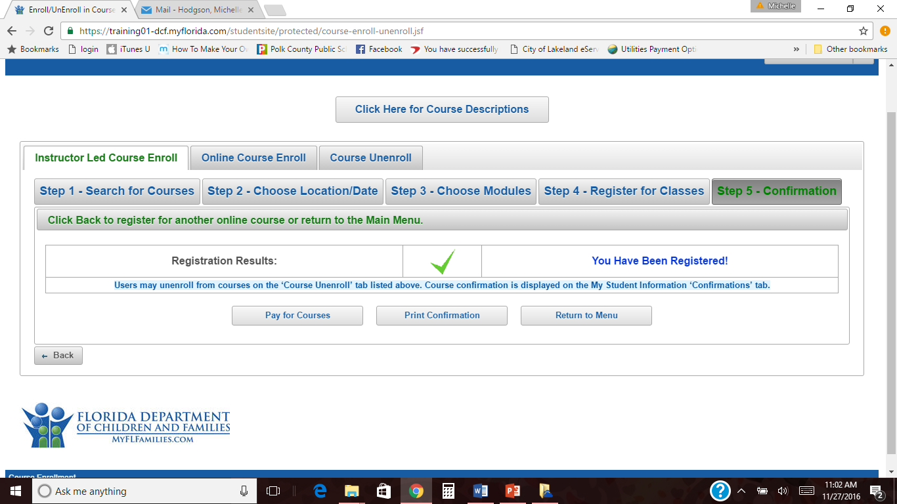
This is Step 5 of Course Enrollment.
You are now enrolled!
You can log out now.

